Slide 1
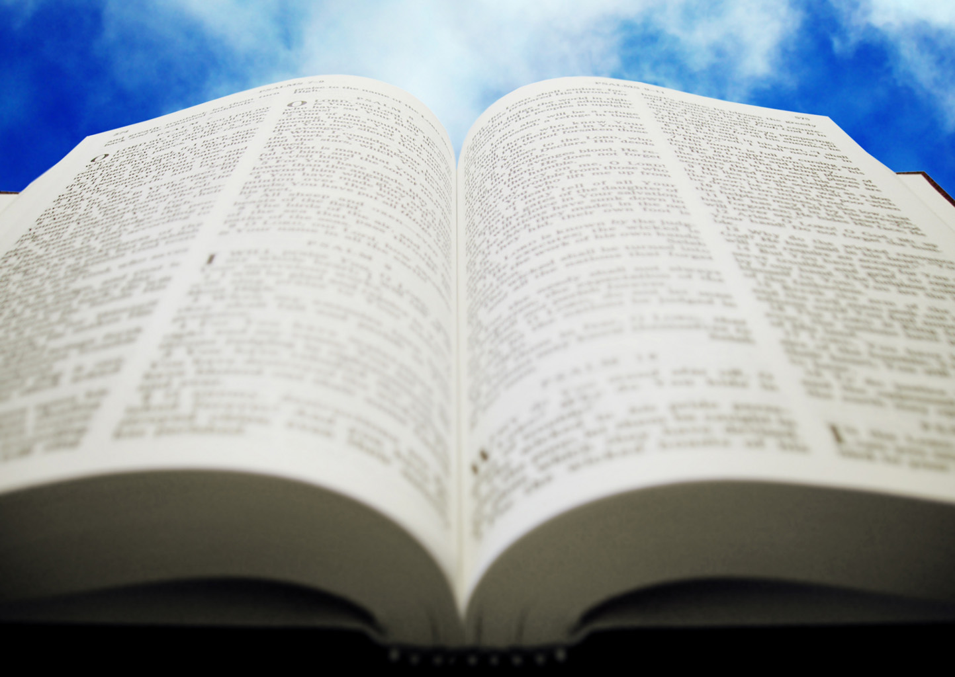
Welcome!
Sunday
Worship 10:00 AM
Sunday
Bible Class (Livestream) 5:00 PM
Wednesday
Bible Class 7:00 PM
www.SunsetchurchofChrist.net

Slide 2
Opening Prayer | Anthony Ward
Song – 68 | Craig Foster
Song – 167 | Craig Foster
Lord’s Supper | Rob Wade
Song – 112 | Craig Foster
Song – 630 | Craig Foster
Lesson | Brian Haines
Song – 268 | Craig Foster
Closing | Michael Hetzer
1 Corinthians 16:2
On the first day of the week let each one of you lay something aside, storing up as he may prosper, that there be no collections when I come.
The collection basket
is in the foyer

Slide 3
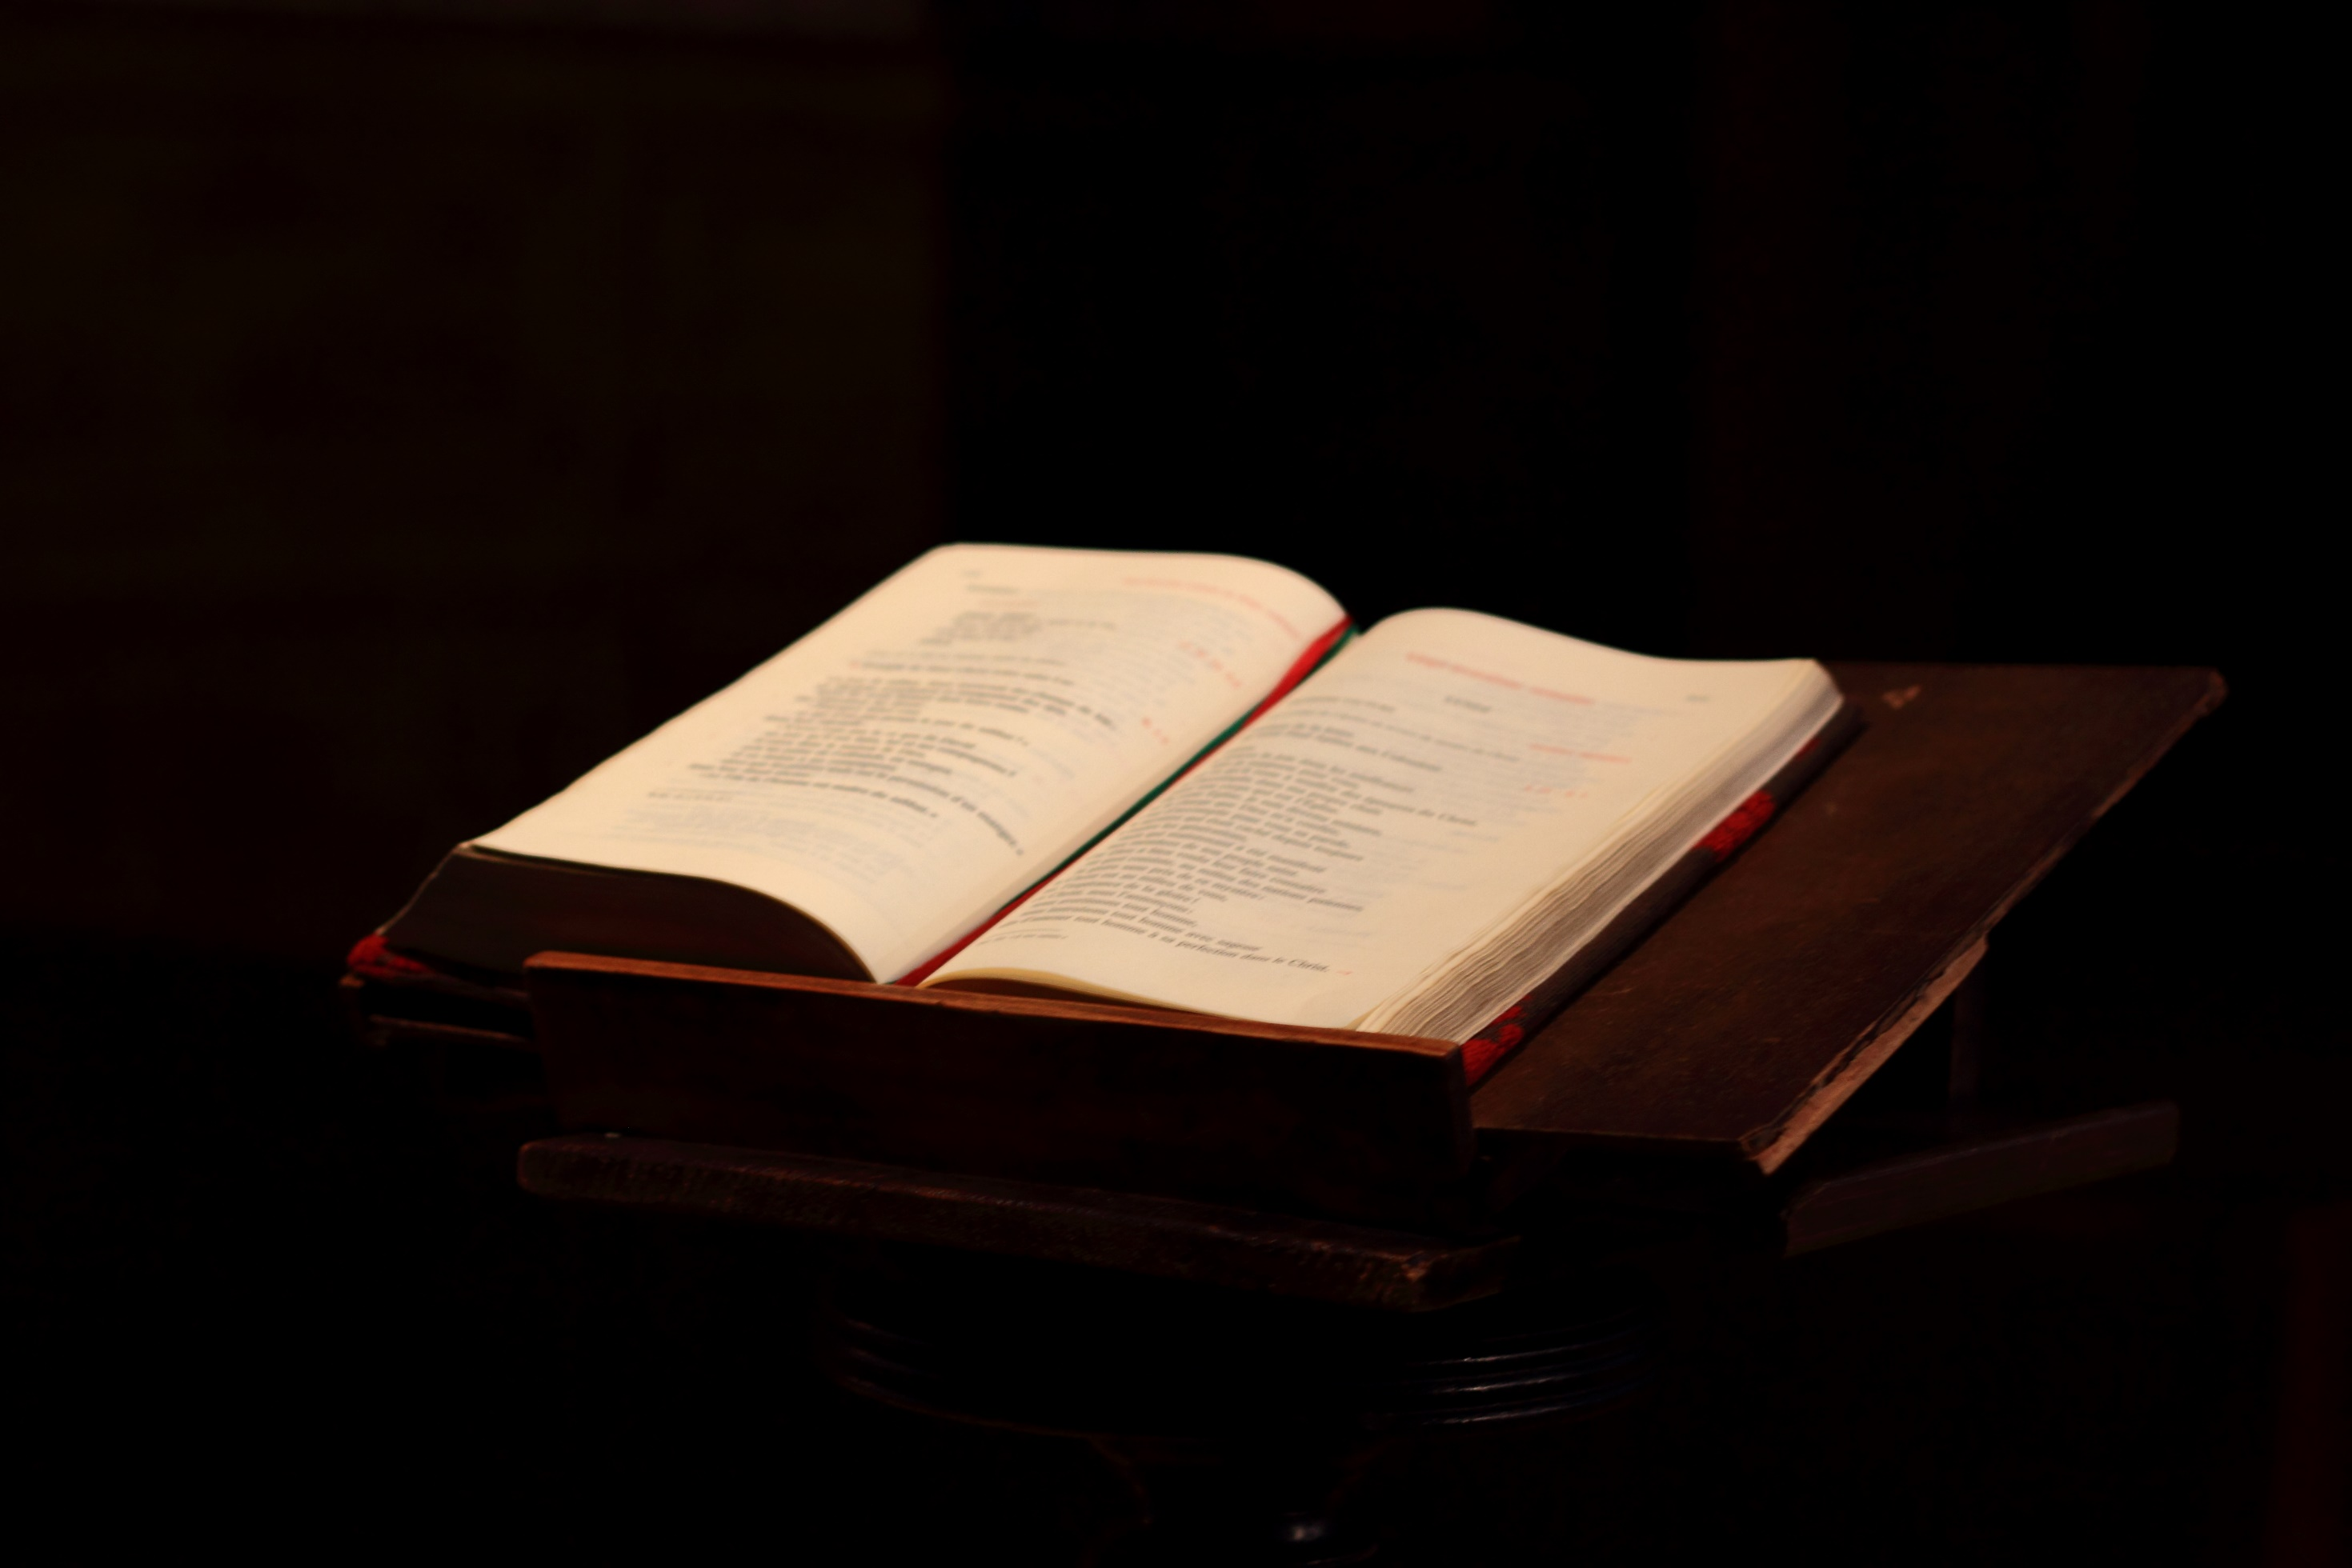
Thoroughly Equipped: Understanding Revelation (Pt 2)

Slide 4
Keys to Revelation
The first verse is the most important
The 7 Churches teach an important lesson
Much of the vision is previous prophecy
The last portion is a message of hope
Notes:
Difficult people tend to be the best at identifying difficult people

Slide 5
Keys to Revelation
Different (Scriptural) views of Revelation
- A discussion of Jewish persecution
- A discussion of Roman persecution
- A discussion of Catholic persecution
Notes:
Difficult people tend to be the best at identifying difficult people

Slide 6
Revisiting Prophecy
Revelation 4-5 visits heaven
Restating Ezekiel 1-4
Revelation 6-9 and the end of Jerusalem
Restating Matthew 24
Restating Zechariah
Revelation 12-17 and the end of Rome
Restating Daniel 7

Slide 7
Revisiting Prophecy
Revelation 4-5 visits heaven
Restating Ezekiel 1-4

Slide 8
A View of Heaven (4-5)
John Saw | Ezekiel Saw
A door opened in Heaven | Heavens opened and with visions of God
Flashes of lightning | A cloud with lightning
4 living creatures | 4 living beings with human form:
Had many eyes, each with 6 wings | 4 faces and four wings
Face of a man, a bull, an eagle, a lion | Face of a lion, a man, eagle and bull
7 lamps of fire | Among them were fires darting around
7 lamps of fire = 7 Spirits of God | Each creature followed a Spirit
Something like a sea of crystal | A great expanse of something like crystal
A sound like thunder | A loud rushing noise like abundant waters
The Throne of Jasper and Sardius | The Throne appeared of Lapus Lazuli
A rainbow like an emerald at the throne | Radiance like a rainbow

Slide 9
A View of Heaven (4-5)
Rainbow – sign of a covenant (Gen. 9:13)
The One in Heaven – God (1 Tim. 6:16)
24 elders – Old Covenant, New Covenant
12 Apostles of Christ
12 Sons of Jacob

Slide 10
A View of Heaven (4-5)
Rainbow – sign of a covenant (Gen. 9:13)
The One in Heaven – God (1 Tim. 6:16)
24 elders – Old Covenant, New Covenant
7 Spirits of God – Knowledge (Isa. 11:2)
The 7 Seals – all authority (Matt. 28:18)

Slide 11
Opening Seals (6)
The 1st Seal: The Conquering King
The 2nd Seal: War
The 3rd Seal: Famine
The 4th Seal: Death
The 5th Seal: Delivery of the Saints
The 6th Seal: Shaking of the earth

Slide 12
Opening Seals
6 Seals Opened: | Jesus’ Prophesy in Matthew 24, Luke 21, Mark 13:
White Horse: Christ is crowned | (Matthew 28:19; overcome the world)
Red Horse: War | Matthew 24:6; war and rumor of war
Black Horse: Famine | Matthew 24:7; There will be famines
Pale Horse: Death/Famine/Pestilence | Luke 21:11; There will be plagues and famine
Martyrs of the Cause of Christ | Luke 21:12-16; persecution and death
Earthquake, darkened sun, falling stars | Luke 21:25-26; signs from heaven, signs in the sun, moon and stars, the powers of heaven
The men of the world calling the mountains and rocks to fall on them | Luke 23:30 Some will call the rocks to fall on them (on the road to the cross)
A fig tree example | Mark 13:28 a fig tree example

Slide 13
God Deliver’s His People (7)
Matthew 24:31 "And He will send His angels with a great sound of a trumpet, and they will gather together His elect from the four winds, from one end of heaven to the other.”

Slide 14
God Deliver’s His People (7)
Zechariah 14:5-6 Then you shall flee through My mountain valley, For the mountain valley shall reach to Azal. Yes, you shall flee As you fled from the earthquake In the days of Uzziah king of Judah. Thus the LORD my God will come, And all the saints with You. It shall come to pass in that day That there will be no light; The lights will diminish.

Slide 15
God Deliver’s His People (7)
Total deliverance of God’s people
12x12x1000 = 144,000
Escaping the “Tribulation”
Spiritual Jerusalem (Zechariah 13-14)
Delivered by Angels = by the Word

Slide 16
God Deliver’s His People (7)
But the people of the church in Jerusalem had been commanded by a revelation, vouchsafed to approved men there before the war, to leave the city and to dwell in a certain town of Perea called Pella.
Eusebius Pamphili, History of the Church (5.3)

Slide 17
Seven Trumpets (8-9)
The Destruction of Jerusalem and the Temple
Matthew 24:29 "Immediately after the tribulation of those days the sun will be darkened, and the moon will not give its light; the stars will fall from heaven, and the powers of the heavens will be shaken.”

Slide 18
Seven Trumpets (8-9)
The Destruction of Jerusalem and the Temple
Image of Jerusalem compared to Egypt
Revelation 11:8 And their dead bodies will lie in the street of the great city which spiritually is called Sodom and Egypt, where also our Lord was crucified.

Slide 19
6 Trumpets | Plagues of Egypt
First Trumpet: Hail and Fire | Plague of Hail and Fire from the Sky
Second Trumpet: A third of the sea becomes blood | Plague of Blood in the Water
Third Trumpet: A great star (Wormwood) poisoned 1/3 of the water | Plague of Blood in the Water
Fourth Trumpet: Sun, moon and stars darkened | Plague of Darkness
Fifth Trumpet (woe): The abyss is opened and locusts come out | Plague of Insects
Sixth Trumpet (woe): The 4 angels kill 1/3 of mankind | Plague of the Death of the Firstborn

Slide 20
Seven Trumpets (8-9)
Abaddon/Apollyon – The Destroyer
Probably not a literal angel or person
Most likely a personification of destruction

Slide 21
Seven Trumpets (8-9)
Abaddon/Apollyon – The Destroyer
Exodus 12:23 For the LORD will pass through to strike the Egyptians; and when He sees the blood on the lintel and on the two doorposts, the LORD will pass over the door and not allow the destroyer to come into your houses to strike you.

Slide 22
Seven Trumpets (8-9)
Point of the Seven trumpets:
-To focus on the terrible destruction
-To focus that even then they would not repent
Matthew 23:37 … I wanted to gather your children together, as a hen gathers her chicks under her wings, but you were not willing!

Slide 23
Jesus Comes in Vengeance (10)
Descending “in the clouds”
The mystery is finished
Ephesians 3:3,6 how that by revelation He made known to me the mystery……. that the Gentiles should be fellow heirs, of the same body, and partakers of His promise in Christ….

Slide 24
A Change of Prophecy
A new prophecy
"You must prophesy again about many peoples, nations, tongues, and kings"

Slide 26
The Promises of Judgment
For the time has come for judgment to begin at the house of God; and if it begins with us first, what will be the end of those who do not obey the gospel of God? 1 Peter 4:17
Notes:
Ac 15:11 "But we believe that we are saved through the grace of the Lord Jesus, in the same way as they also are."

Slide 27
How to Obey the Gospel
Or do you not know that as many of us as were baptized into Christ Jesus were baptized into His death? Therefore we were buried with Him through baptism into death, that just as Christ was raised from the dead by the glory of the Father, even so we also should walk in newness of life. Romans 6:3-4
Notes:
Ac 15:11 "But we believe that we are saved through the grace of the Lord Jesus, in the same way as they also are."

